Slide 1
Hemodialysis
Practical lecture
By
A.L. MAHER ABDUL AMEER

Slide 2
Anatomy of kidney

Slide 4
What is dialysis?
The kidneys filter the blood by removing waste and excess fluid from the body. This waste is sent to the bladder to be eliminated when urinate.
Dialysis performs the function of the kidneys if they’ve failed. According to the National Kidney Foundation, end-stage kidney failure occurs when the kidneys are performing at only 10 to 15 percent of their normal function.

Slide 5
Why is dialysis used?
Properly functioning kidneys prevent extra water, waste, and other impurities from accumulating in the body.
They also help control blood pressure and regulate the levels of chemical elements in the blood.
These elements may include sodium and potassium. the kidneys even activate a form of vitamin D that improves the absorption of calcium.
When the kidneys can’t perform these functions due to disease or injury, dialysis can help keep the body running as normally as possible.
Without dialysis, salts and other waste products will accumulate in the blood, poison the body, and damage other organs.

Slide 6
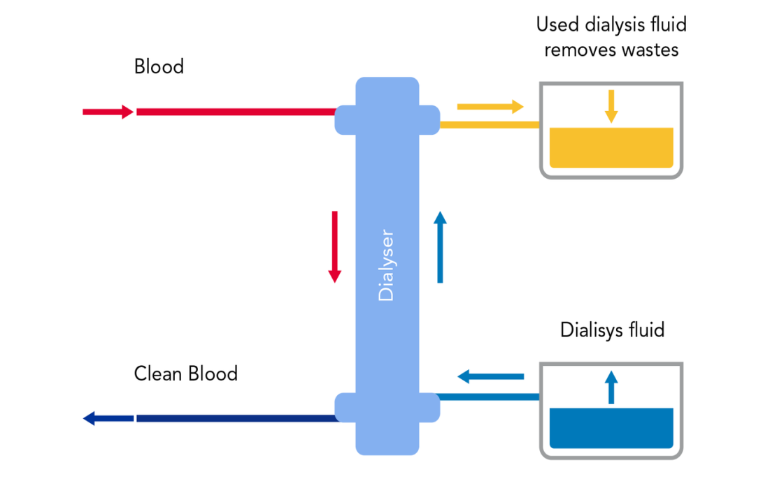
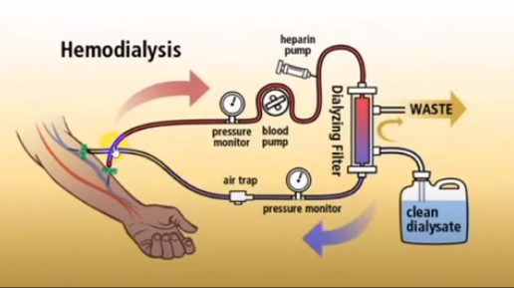
Hemodialysis
Hemodialysis is the process by which blood is removed from the body cleaned from toxins and extra fluid then returned to the body again

Slide 7
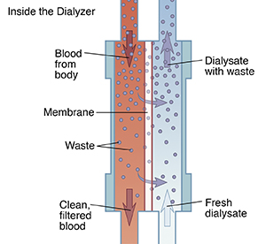
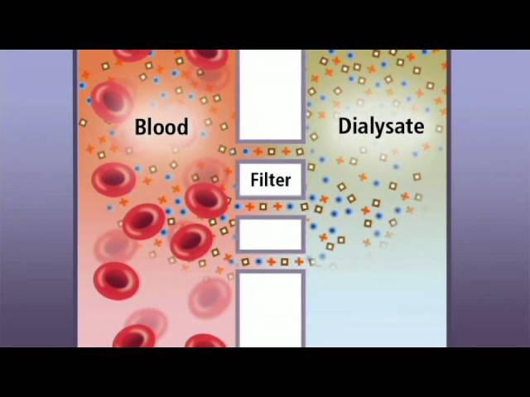
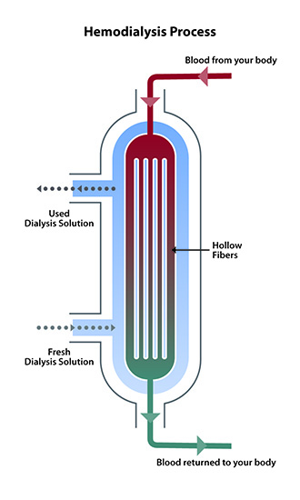
Dialyzer/filter process

Slide 8
Dialysis schedule
Three time a week:
Each other day
Each session last about 3-4 hr. according pt. tolerance
Blood flow rate(pump)= 250: 400ml/min

Slide 9
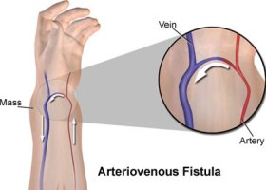
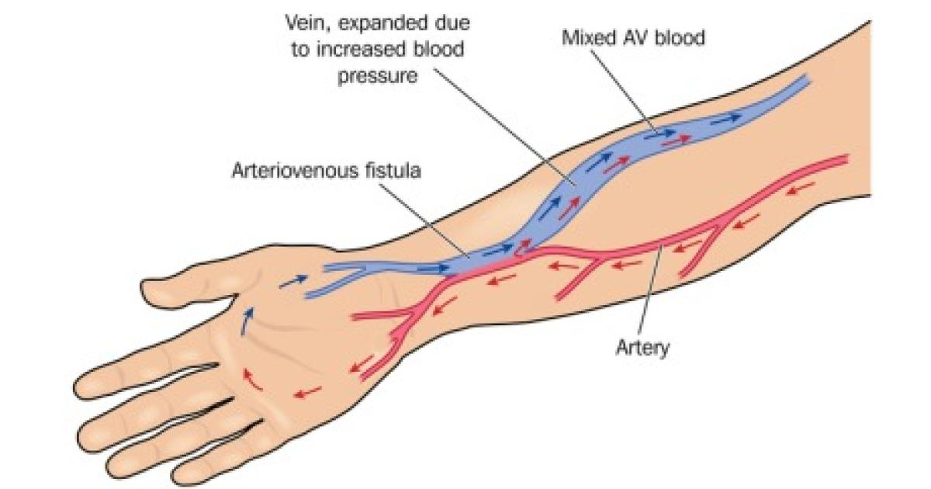
Hemodialysis vascular access
The three types of vascular access are:
Arteriovenous (AV) fistula: one vein is reconnected directly to an artery used 2-3 months after surgery
.

Slide 10
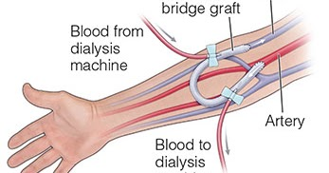
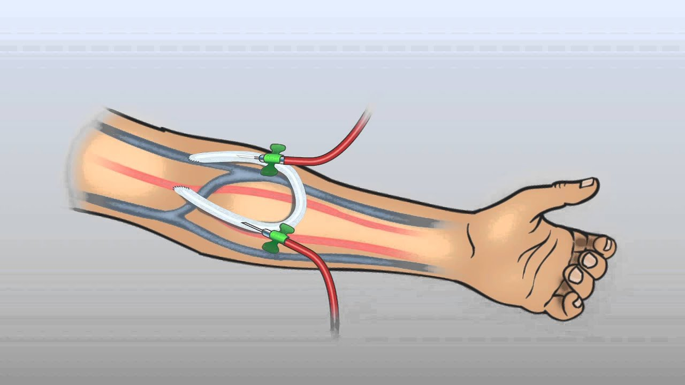
Arteriovenous (AV) graft: an artificial tube is inserted just under the skin and is connected one end an artery and other end to a vein used 2-3 week after surgery

Slide 11
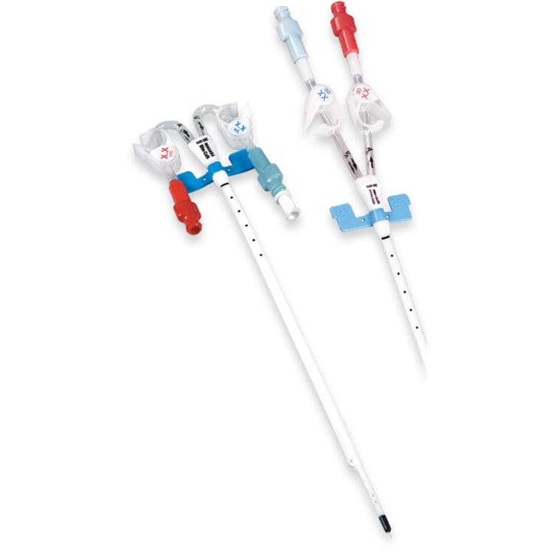
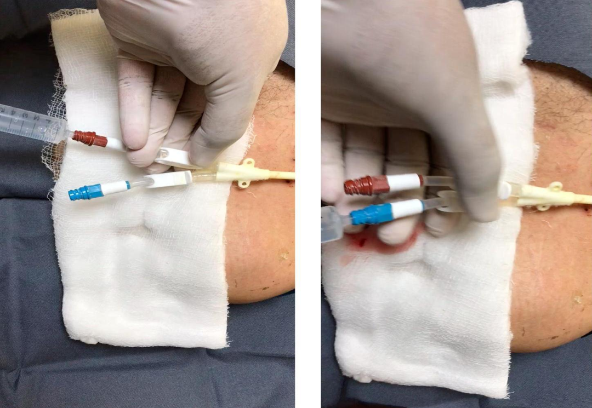
Catheter: is along two sided tube inserted through the skin and into the vein used immediately after insertion

Slide 12
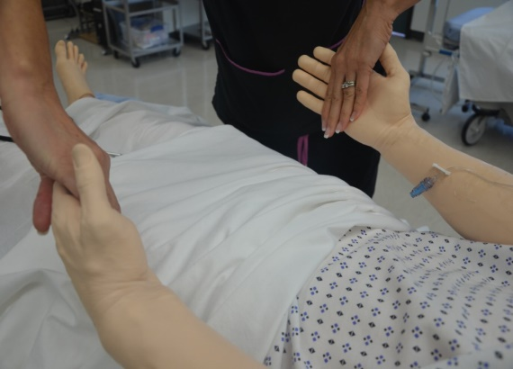
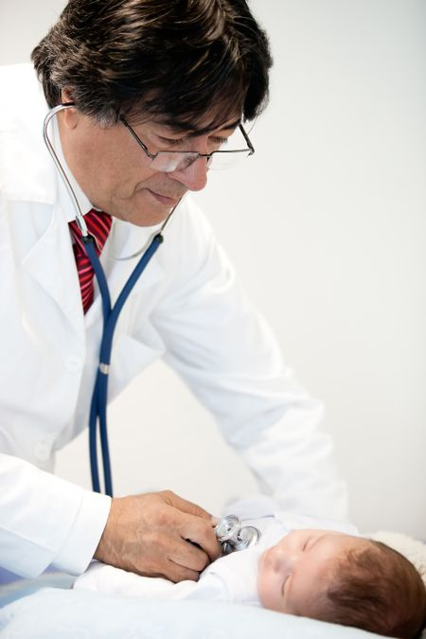
Hemodialysis vascular access
look
feel
listen

Slide 13
look
Redness
Bleeding
Drainage
Tenderness
Aneurysms formation
Skin irritation

Slide 14
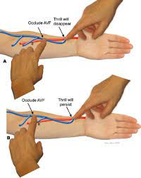
feel
Palpate thrill

Slide 15
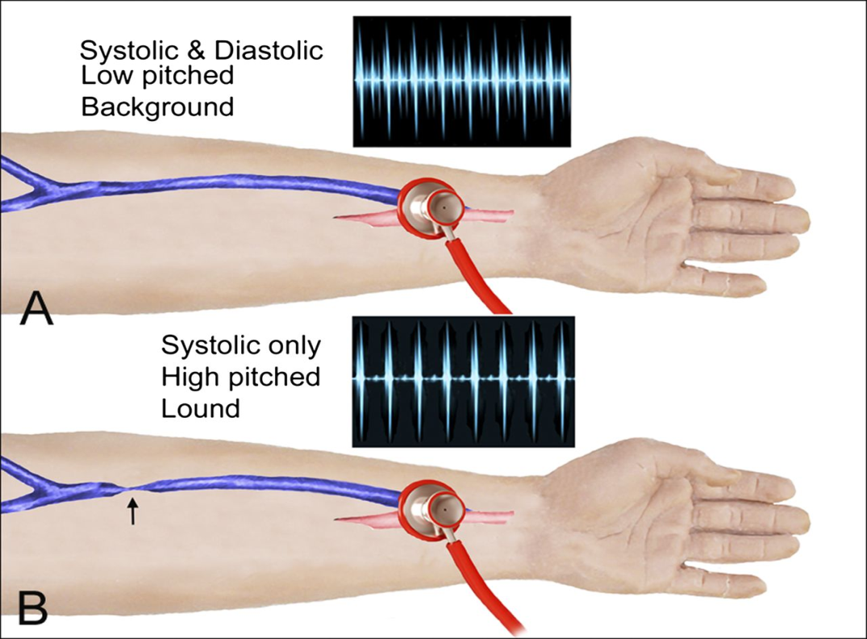
listen
Listen bruit

Slide 16
Patient instruction
No carry heavy objects
No pushing heavy objects
No sleep on fistula/ graft arm
No measure B.P. from fistula/ graft arm
No measure blood sample from fistula/ graft arm
No jewelry in fistula arm
No tight cloths

Slide 17
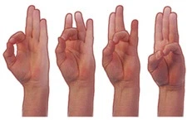
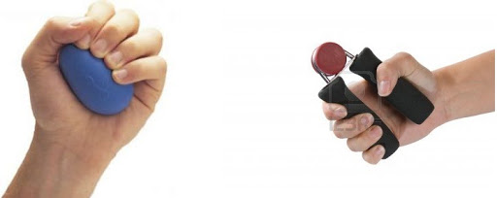
Way to prolong the life fistula /graft
Exercise the arm daily. 5 minute twice a day
This will help the fistula to develop

Slide 18
Phases of patient care
Pre- dialysis phase
Intra- dialysis phase
Termination phase

Slide 19
A-Preparation the equipment
Dialyzer
Machine and blood line
1000 ml normal saline
Heparin(5000iu)
Sterile towel
Sterile gauze pads
Antiseptic solution
Syringe
Fistula needle
Personal protective barriers
Adhesive tape

Slide 20
B-pre –dialysis assessment
Vital signs
Patient weight
Patient skin color or integrity
Vascular access by palpating thrill
Fluid status: edema / neck vein congestion
Laboratory result

Slide 21
C- patient preparation
Explain procedure to patient
Asked the patient to evacuate the bladder before start session defecation- urine
Asked the patient to wash his arm from hand to elbow with water and soap and dry it by clean towel
Put patient in comfortable position

Slide 22
D- machine preparation
Under filtration(UF) volume:ساحب اشكد للحد هسة
Under filtration(UF) rate:معدل السحب في الساعة
Under filtration(UF) goal:اشكد زايد وزنة من اخر جلسة
Time lift:باقي اشكد من الوقت وتخلص الجلسة الغسل

Slide 23
After dialysis care
Stripe machine and dispose of all equipment
Rinse and disinfect machine
Clean machine externally
Record weight, blood pressure and pulse
Hand hygiene

Slide 24
Risks associated with hemodialysis
low blood pressure
anemia, or not having enough red blood cells
muscle cramping
difficulty sleeping
itching
high blood potassium levels
pericarditis, an inflammation of the membrane around the heart
sepsis
bacteremia, or a bloodstream infection
irregular heartbeat
sudden cardiac death, the leading cause of death in people undergoing dialysis

Slide 25
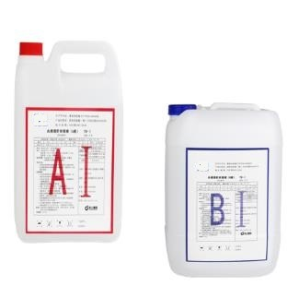
Dialysate solution

Slide 26
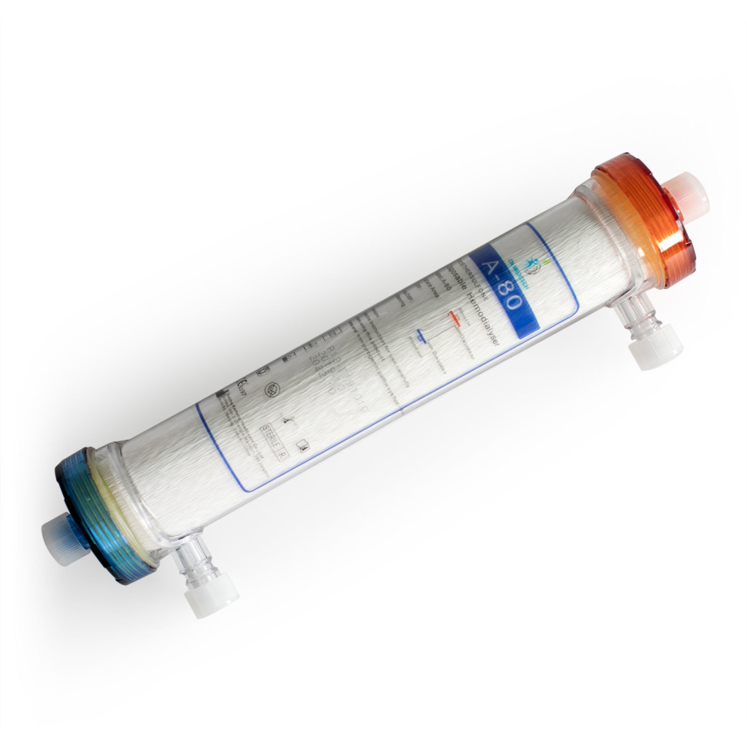
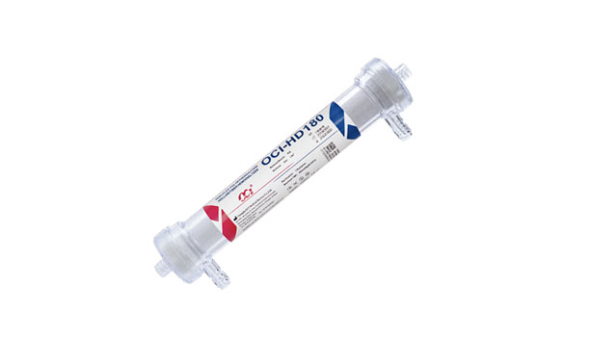
Filter Or Dialyzer

Slide 27
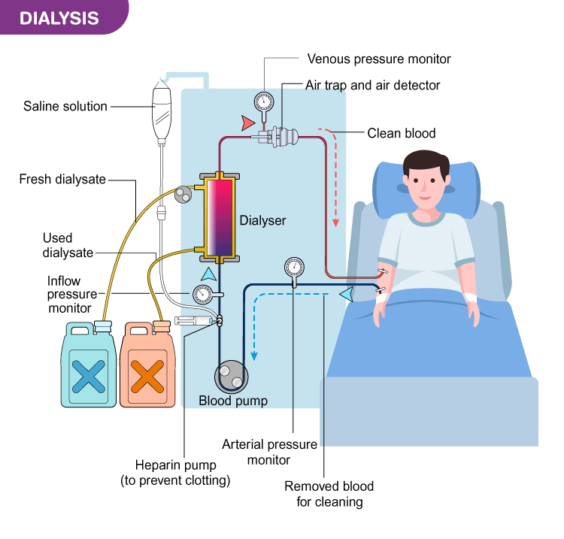
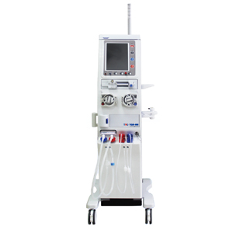

Slide 28
What does a dialysis machine do?

